Slide 1

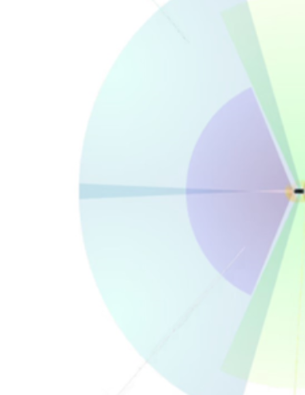



Front Object CCD Camera
An Embedded Systems Perspective
Singarayacheruvu Sreekar Kanchana Naga Kumar
Matrikel Nr: 846217 Matrikel Nr: 862624
MEASUREMENT AND SENSOR TECHNOLOGY

Slide 2

List of Contents
Introduction
CCD Sensor Working Principle
CCD Sensor Design & Architecture
Sensor Placement & Importance
Design Requirements for Automotive Use
State of the Art in CCD Sensors
Integration with Embedded Systems
Recent Improvements & Research Trends
Applications of Front Object CCD Cameras
Challenges & Limitations
Conclusion
References

Slide 3

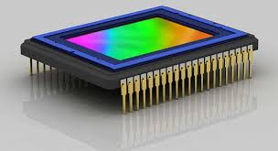
Introduction
CCD = Charge-Coupled Device: a sensor that converts light into electronic signals.
Used in high-quality imaging, low noise, and superior light sensitivity.
Importance in front object detection especially for ADAS, robotics, industrial applications, etc.
Embedded systems enable fast, efficient image acquisition and decision-making by processing CCD sensor data in real time with minimal power consumption.
Fig 1: CCD Triclops [8]
Fig 2: CCD Sensor [9]

Slide 4
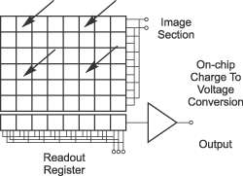
CCD Sensor Working Principle
Light hits the sensor.
Photon → electron conversion.
Charge moves across the chip via capacitive coupling.
Final stage: charges converted into voltage, amplified, and digitized.
🌞 Light → 📸 Sensor → ⚡ Electrons → 🔄 Charge Movement
→
💻 Digitized Signal ← 📈 Amplified ← 🔋 Voltage
→
Fig 3: CCD Sensor Structure [10]

Slide 5
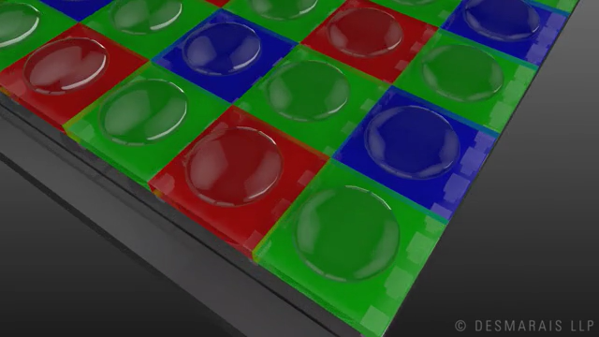
CCD Sensor Design & Architecture
Key components:
Photodiodes (pixels)
Vertical shift register
Horizontal register
Output amplifier
Fig 4: CCD Architecture [11]
Fig 5: CCD Animation Sequence [12]

Slide 6
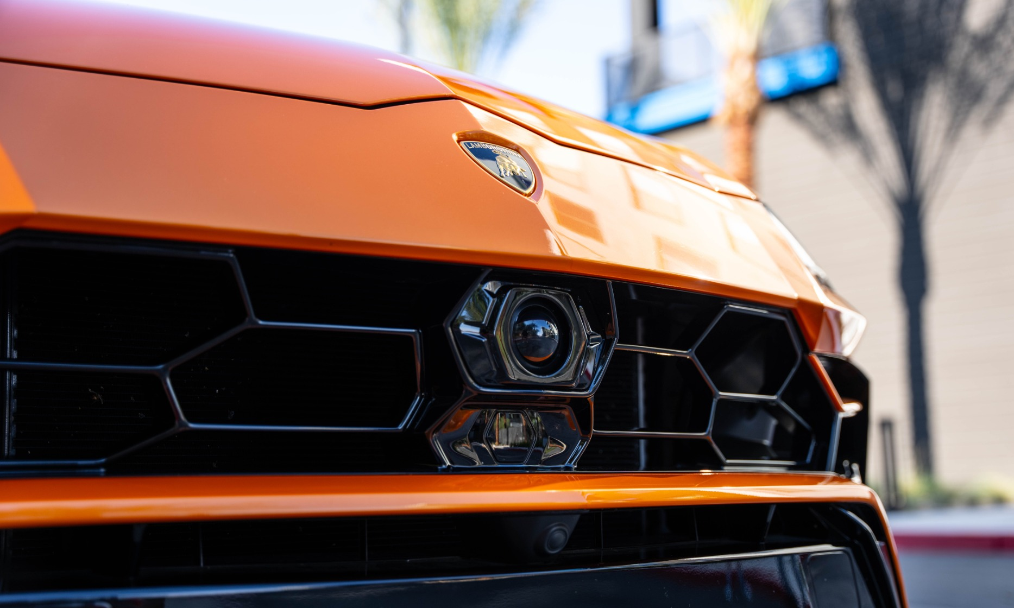
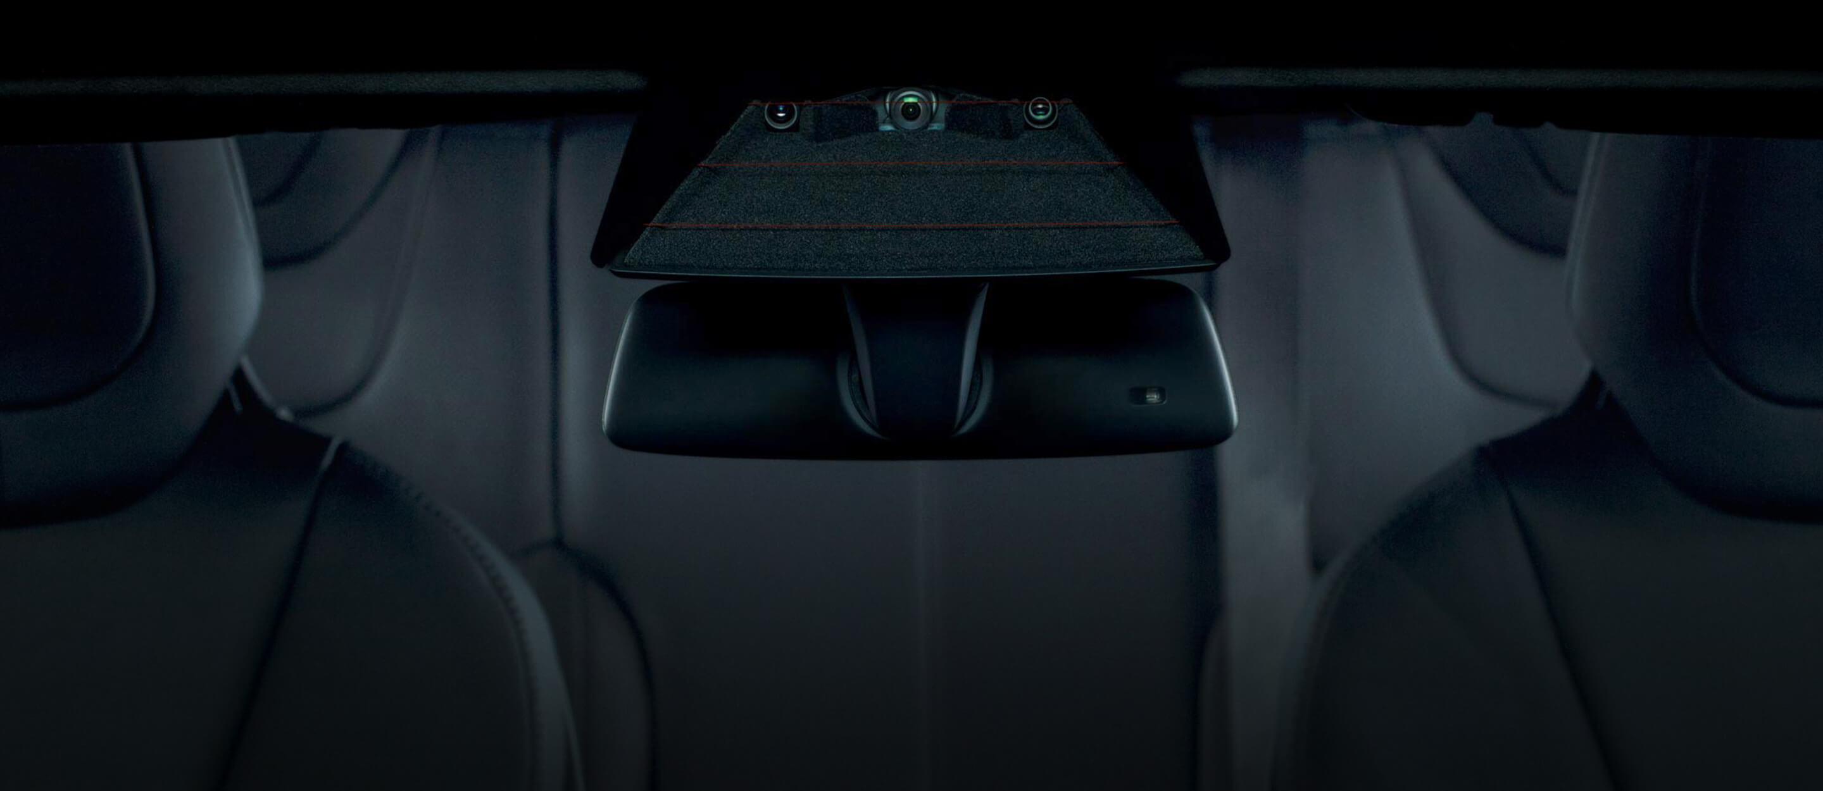
Sensor Placement & Importance
Placed at the windshield, front grille, or bumper for a clear forward view.
Minimizes vibration and aligns with the driver’s natural line of sight.
Windshield mounting protects against debris, water, and glare.
Centered position ensures accurate, symmetrical field of view.
Enables low-latency image capture for real-time detection and processing.
Fig 6: CCD Camera at Front Grille [13]
Fig 7: CCD Camera at Windshield [8]

Slide 7
Design Requirements for Automotive Use
Operate reliably across varying light conditions (day/night).
Ensure high sensitivity and low noise in low-light environments.
Support fast readout for real-time processing.
Be robust against vibrations, heat, and humidity.
Maintain a compact, low-power profile for embedded integration.

Slide 8
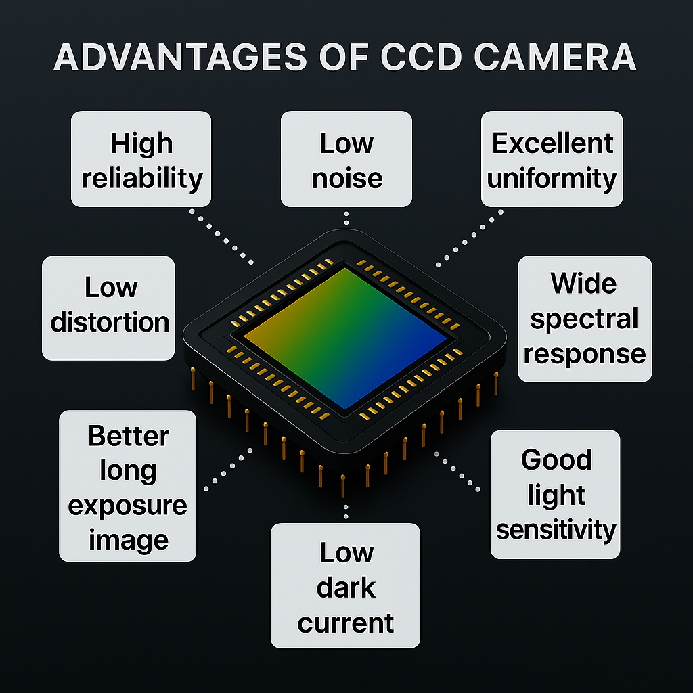
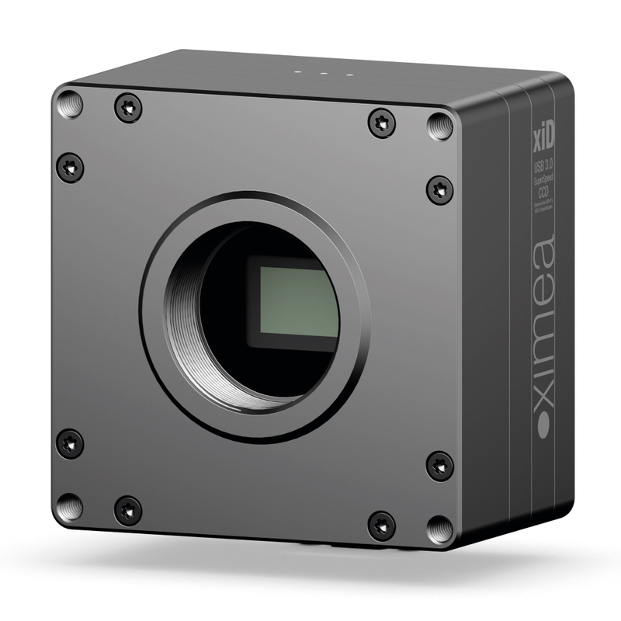
State of the Art in CCD Sensors
High-speed CCDs (e.g., frame-transfer models)
Low-noise CCDs for enhanced imaging
Hybrid sensors (CCD + CMOS architecture)
Industry players: Sony, ON Semiconductor
Example: Sony ICX series offers high-resolution, high-sensitivity sensors with frame rates suitable for automotive needs.
Fig 8: SONY ICX674 CCD sensor [14]

Slide 9
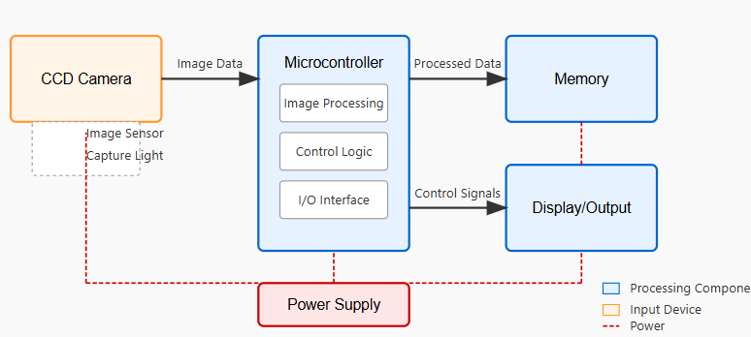
Integration with Embedded Systems
CCD sends analog signals → digitized via ADC
Embedded processor handles:
Signal processing
Control signals
Data storage/transfer
Importance of timing, low power, and latency
Fig 9: Embedded System with CCD Camera Interface

Slide 10
Recent Improvements & Research Trends
In-sensor computing allows some image processing to occur directly on the sensor chip.
Edge AI integration enables object recognition tasks within the camera module.
Advanced CCDs feature increased quantum efficiency, extended spectral sensitivity, and better anti-blooming control.
Research in processing-in-pixel architectures aims to reduce latency and power.
Papers from ACM and IEEE highlight these trends as part of next generation embedded vision systems.

Slide 11
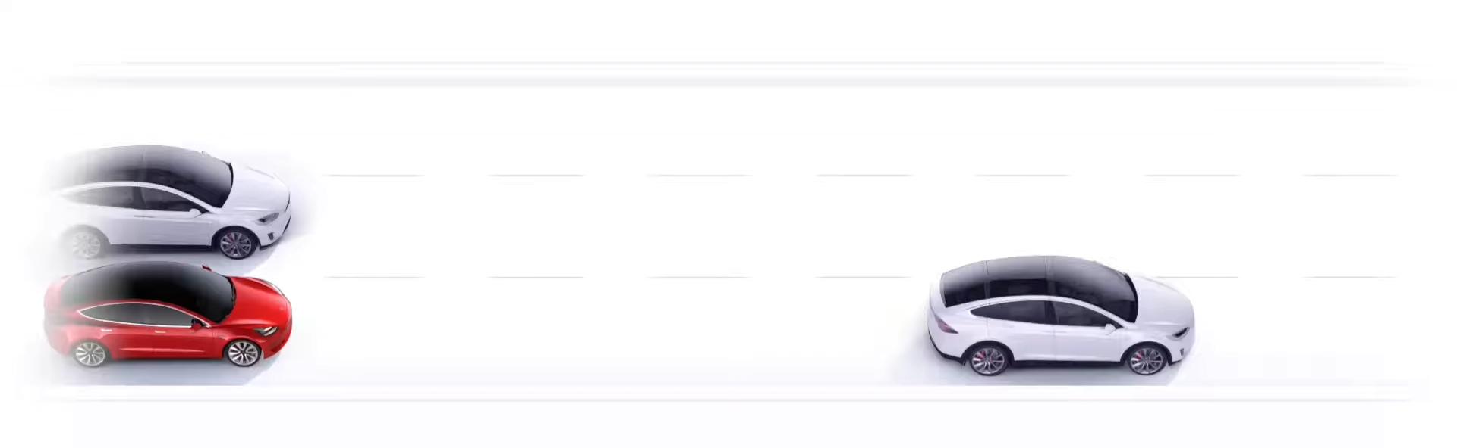
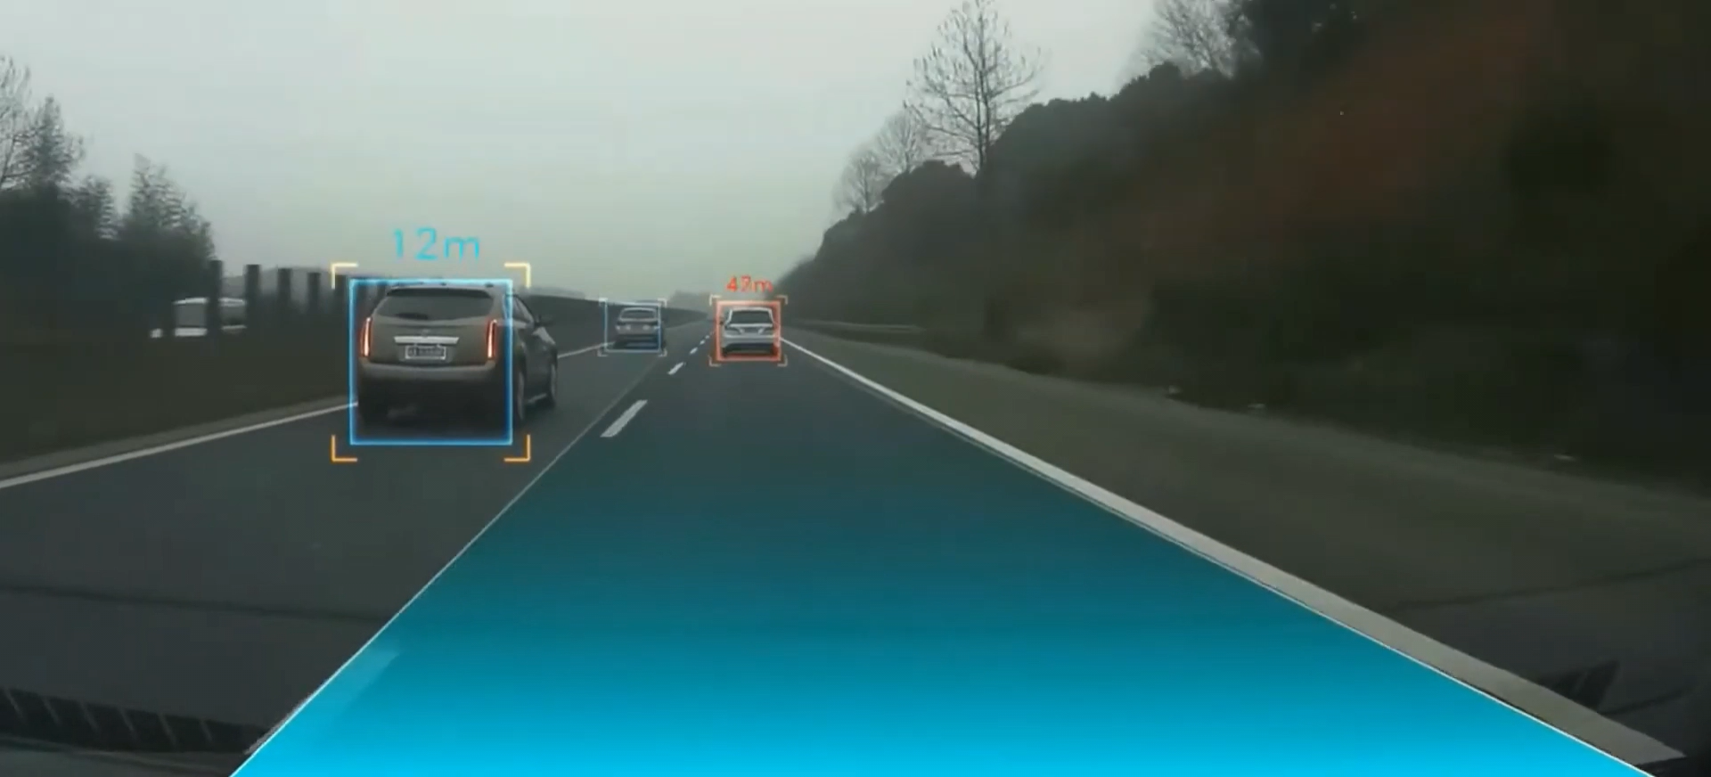
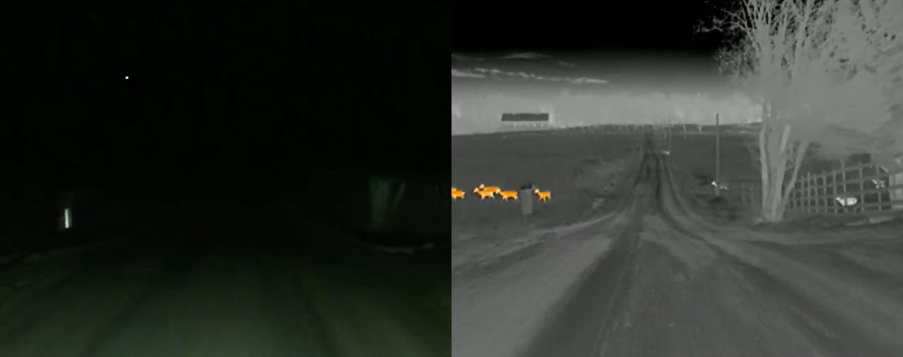
Applications of Front Object CCD Cameras
Detects obstacles/objects directly in front
Front object detection requires fast + reliable imaging = CCD Camera
Used in Automotive: ADAS, Autopilot, Night vision

Slide 12
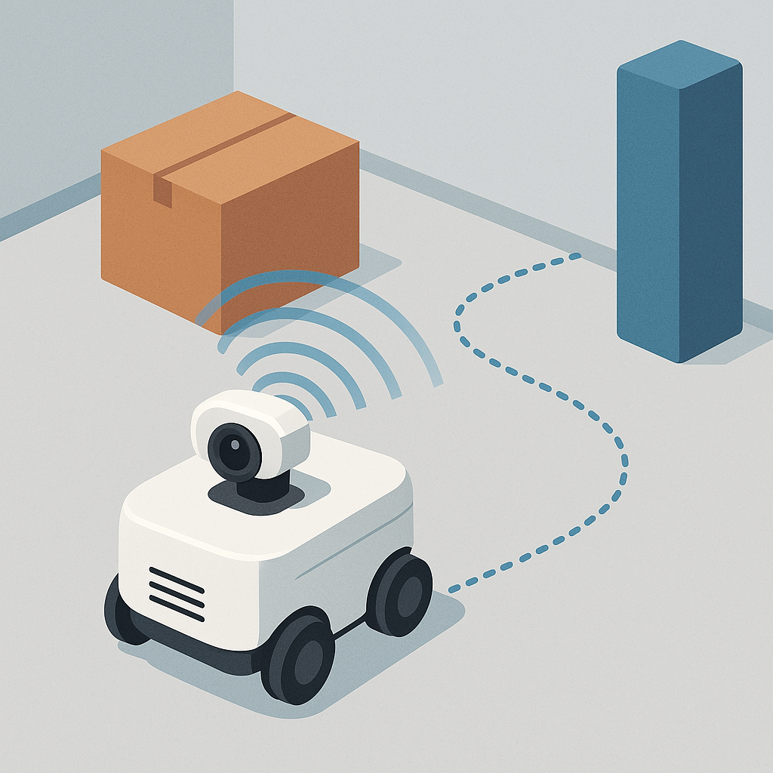

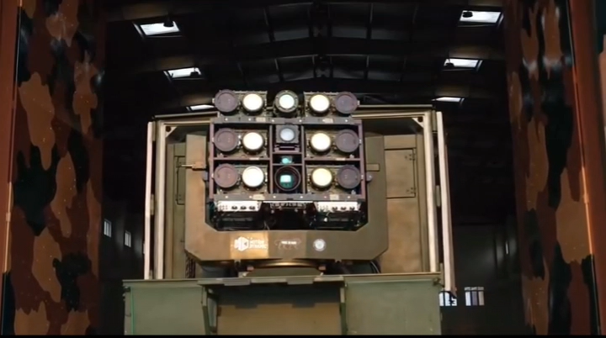
Applications of Front Object CCD Cameras
Used in Robotics: Obstacle detection, Navigation
Industrial: Object sorting
Drones: Terrain avoidance, War assist

Slide 13
Challenges & Limitations
Expensive compared to CMOS
Higher power consumption
Slower readout
Accuracy:
Daylight 85 - 95% (Object Detection)
Nightlight 60 - 75% (With IR Illumination)
Signal-to-Noise Ratio (SNR):
Daylight: 50 - 60 dB (Excellent)
Night: Drops to 30 - 40 dB (without IR)
Dynamic Range: Up to 72 dB (HDR) but degrades in low light due to read noise.
Exposure Limits:
Min: 1 µs (prevents motion blur)
Max: 200 ms (for low-light integration)

Slide 14
Conclusion
CCD sensors offer high-quality imaging with excellent light sensitivity, ideal for front object detection in ADAS and robotics.
They work by converting photons to electrons, transferring charge efficiently, and producing digitized signals for precise imaging.
Strategic placement (e.g., windshield, grille) ensures optimal field of view, low vibration impact, and real-time responsiveness.
Designed to meet automotive-grade demands—handling heat, vibration, and varying light conditions while remaining compact and low-power.
Embedded system integration enables real-time processing, signal control, and data transfer with minimal power and latency.
Despite higher cost and slower readout than CMOS, CCDs excel in SNR, dynamic range, and are advancing with in-sensor AI and hybrid designs.

Slide 15
References
[1] Fossum, E. R.; Teranishi, N.; Theuwissen, A. J. P. Digital Image Sensor Evolution and New Frontiers. Annu. Rev. Vis. Sci. 2024, 10, 171–199. DOI: 10.1146/annurev-vision-101322-105538
[2] Polatoğlu, Ö., & Özkesen, Ö. (2022). Working principles of CCD and CMOS sensors and their importance in astronomical imaging. Journal of Anatolia Physics and Astronomy, 2(1), 51–59.
[3] Cruz, C., & de Vicente, J. (2024). Charge-coupled device readout by digital-correlated double sampling. Frontiers in Detector Science and Technology, 2, 1487623. https://doi.org/10.3389/fdest.2024.1487623
[4] Matos, F.; Bernardino, J.; Durães, J.; Cunha, J. A Survey on Sensor Failures in Autonomous Vehicles: Challenges and Solutions. Sensors 2024, 24 (16), 5108. DOI: 10.3390/s24165108
[5] Hamamatsu Photonics. CCD/CMOS Image Sensors Selection Guide, SSF, 2022. (Hamamatsu tech note)
[6] Akhlaq, M.; Sheltami, T. R.; Helgeson, B.; Shakshuki, E. M. Designing an Integrated Driver Assistance System Using Image Sensors. J. Intell. Manuf. 2014, 25, 913–933. DOI: 10.1007/s10845-011-0618-1
[7] Liu, Y., Wang, S., Xie, Y., Xiong, T., & Wu, M. (2024). A review of sensing technologies for indoor autonomous mobile robots. Sensors, 24(4), 1222. https://doi.org/10.3390/s24041222

Slide 16
References
[8] Tesla, Inc. (2025). CCD Triclops. Tesla. https://www.tesla.com/en_AE/autopilot/%3Fredirect%3Dno
[9] Watterson, D. (2024, July 2). What is the CCD? Detailed explanation. Great Big Photography World. https://greatbigphotographyworld.com/what-is-the-ccd/
[10] Baader Planetarium. (2020, October 26). CCD Architecture: Full Frame, Frame Transfer, and Interline CCD. Baader Planetarium. https://www.baader-planetarium.com/de/blog/ccd-architecture-full-frame-ccd-frame-transfer-and-interline-ccd-beitrag-von-andor-technology/
[11] Matt Williams. (2021, August 4). CCD Architecture. PetaPixel. https://petapixel.com/what-is-ccd-cmos-sensor/
[12] Michael Zhang. (2015, May 5). These Animations Show How CMOS and CCD Sensors Work and How They Differ. PetaPixel. https://petapixel.com/2015/05/05/these-animations-show-how-cmos-and-ccd-sensors-work-and-how-they-differ/
[13] iLusso. (2022). Lamborghini Urus Front Grille. iLusso. https://www.ilusso.com/used-vehicle-2022-lamborghini-urus-pearl-capsule-c-3520/
[14] Ximea. (2017). MD028CU-SY SONY ICX674 CCD Sensor. Ximea. https://www.ximea.com/products/usb-vision-industrial/xid-usb3-scientific-sony-ccd-cameras/sony-icx674aq-usb3-color-scientific-camera

Slide 17
Thank You !

